Slide 1
Flights project
File created on: 12/14/2022 6:52:40 PM

Slide 2
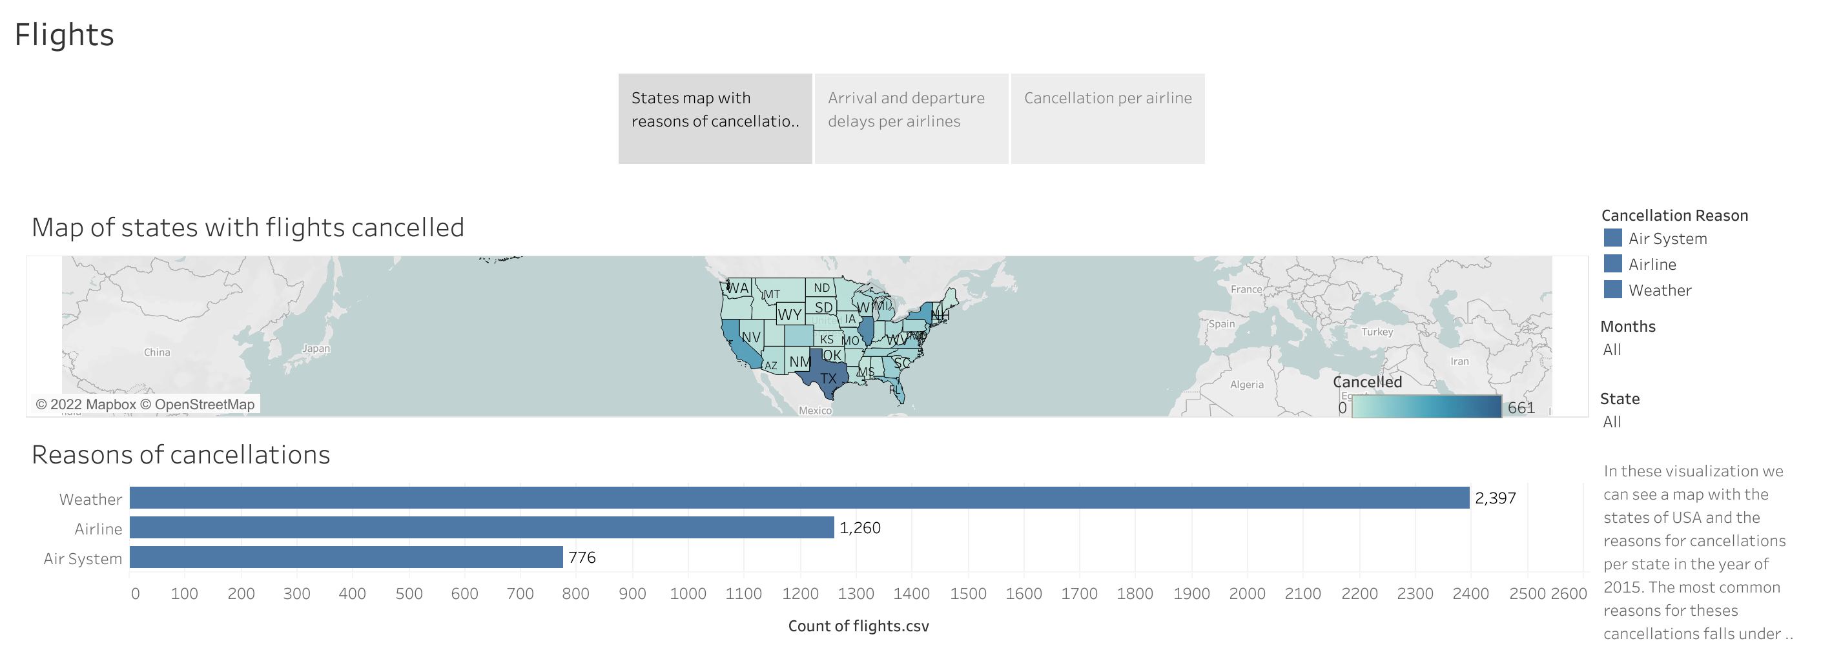

Slide 3
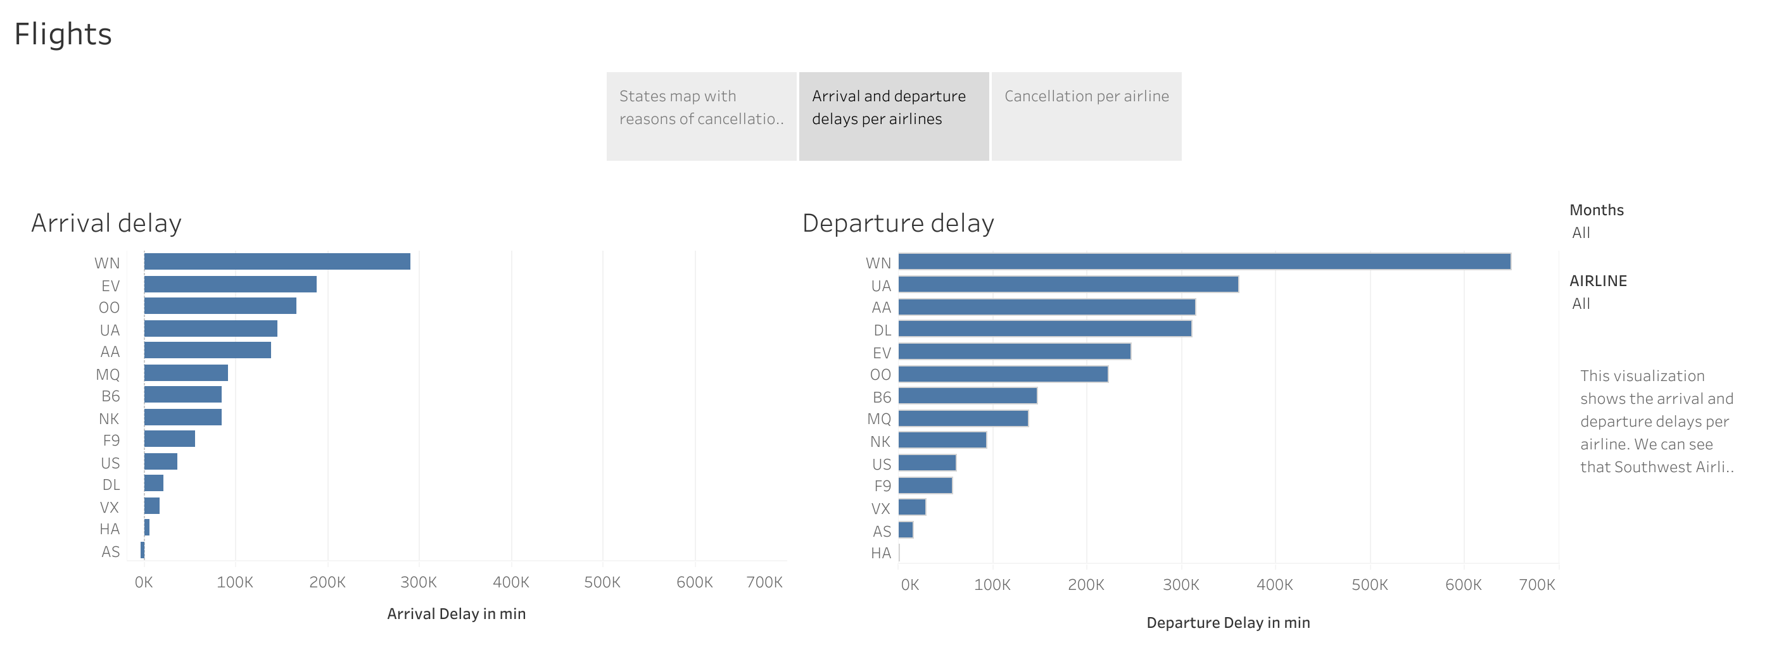

Slide 4
